Slide 1
Chapter 2
Database Design Fundamentals

Slide 2
Outline
Database Concepts
Functional Dependence
Primary Keys
Database Design
Diagrams for Database Design
Normalization

Slide 3
Relational Database
Is a collection of tables.
a concept that does not only follow the hierarchy of data (i.e. Field, Record, Table and Database) data structure but also has a structure that would allow the creation of relationship among its files (i.e. Tables).
Author
AuthorCode
Lastname
Firstname
Gender
Nationality
Books
BookCode
BookTitle
Genre
AuthorCode
Price

Slide 4
Relational Database Management System
A Relational Database Management System or RDBMS is a software that allows the user to create, connect, manage and update Database according to needs.
Popular RDMBS software are Oracle, DB2, mySQL, MS SQL Server and MS Access to name a few.

Slide 5
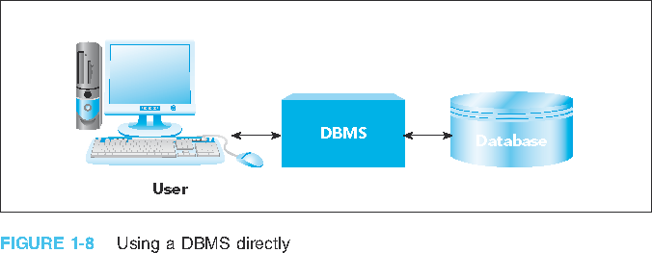
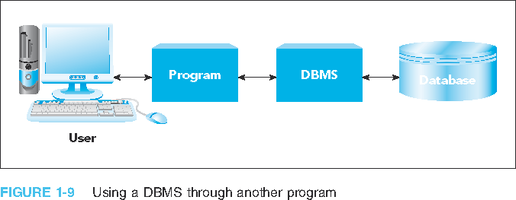
Relational Database Management System
FIGURE 1: Using a DBMS directly
FIGURE 2: Using a DBMS through another program

Slide 6
Database Background
Database
Structure that can store information about:
Different categories (or Entities) of information
Relationships between those categories of information
Entity
is any single person, place, object, event, or idea which a data could be stored.

Slide 7




Database Background
Entity or Category could be a :
(ex. Teacher, Student, Physician)
Person
Place
(ex. School, Hotel, Bank )
Object
(ex. Mouse, Books, Software )
Event
(ex. Enroll, Withdraw, Order )
Idea or Concept
(ex. Courses, Account, Delivery )

Slide 8



Database Background
Entity for Premier Products
Sales Rep
(an example for Person entity)
Customers
(an example for Person entity)
Orders
(an example for Concept or Idea entity )
Parts
(an example of Object entity )

Slide 9
Database Background (continued)
Could you name possible Entities for the following?
Our College
Library

Slide 10
Database Background (continued)
An Entity has an Attribute
Characteristic or property of an entity
Example: Customer has name, street, city, etc.
May also be called a field or column

Slide 11
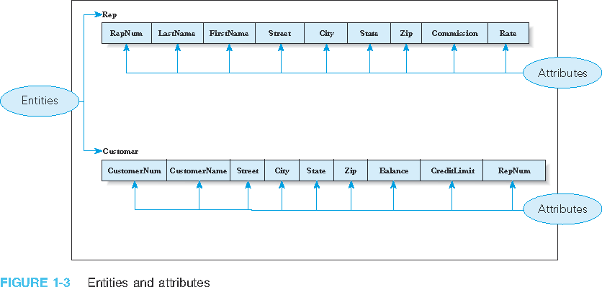
Database Background (continued)
FIGURE 3: Entities and attributes

Slide 12
Database Background (continued)
An Entity could have a Relationship with another Entity
Association between entities
There are three types of Relationship:
One-to-One
One-to-Many (Most common)
Many-to-Many
One-to-many relationship of Premier Products
Each Rep is associated with many Customers
Each Customer is associated with a single Rep

Slide 13
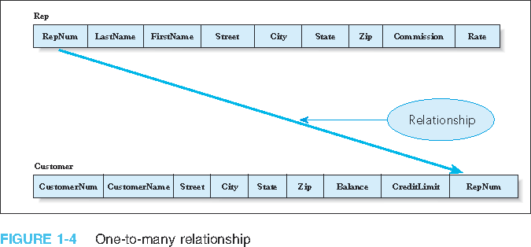
Database Background (continued)
FIGURE 4: One-to-many relationship

Slide 14
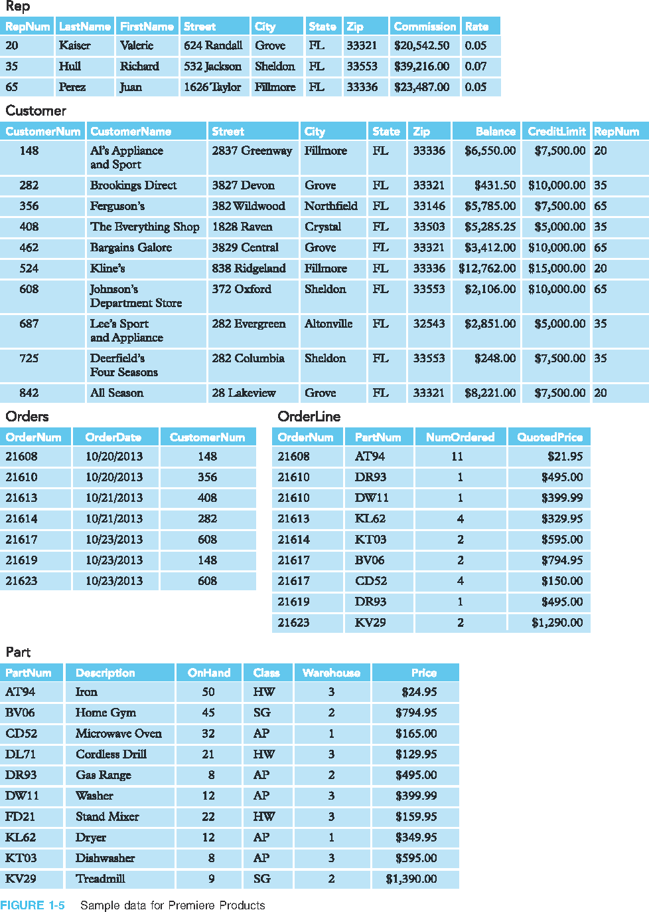
Database Background (continued)
FIGURE 5: Sample data for Premiere Products

Slide 15
Database Background (continued)
FIGURE 6: Sample data for Premiere Products (continued)

Slide 16
Database Background (continued)
FIGURE 7: Sample data for Premiere Products (continued)

Slide 17
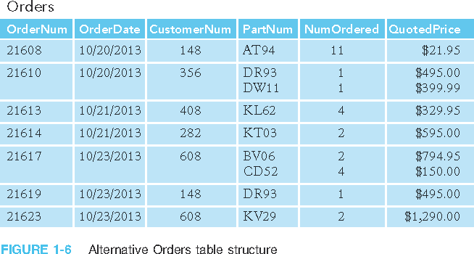
Database Background (continued)
FIGURE 8: Alternative Orders table structure

Slide 18
Database Background (continued)
Entity-relationship (E-R) diagram or also known as ERD
Visual way to represent a database
Rectangles represent entities
Lines represent relationships between connected entities

Slide 19
Figure 9: Segment from enterprise data model

Slide 20
Figure 9: Segment from enterprise data model
One customer may place many orders, but each order is placed by a single customer
→ One-to-many relationship

Slide 21
Figure 9: Segment from enterprise data model
One order has many order lines; each order line is associated with a single order
→ One-to-many relationship

Slide 22
Figure 9: Segment from enterprise data model
One product can be in many order lines, each order line refers to a single product
→ One-to-many relationship

Slide 23
Figure 9: Segment from enterprise data model
Therefore, one order involves many products and one product is involved in many orders
→ Many-to-many relationship

Slide 24
Database Background (continued)
Rep
Customer
RepNum
LastName FirstName Street City State Zip Commission Rate
One
Many
CustomerNum
CustomerName Street City State Zip Balance CreditLimit RepNum
FIGURE 10: Alternative Notation for ERD (Entity-Relationship Diagram)
known as Crow’s Foot Notation

Slide 25
Database Background (continued)
Crow’s Foot Notation
One and only One
One or Many
Zero or Many
FIGURE 11: Alternative Notation for ERD (Entity-Relationship Diagram)
known as Crow’s Foot Notation

Slide 26
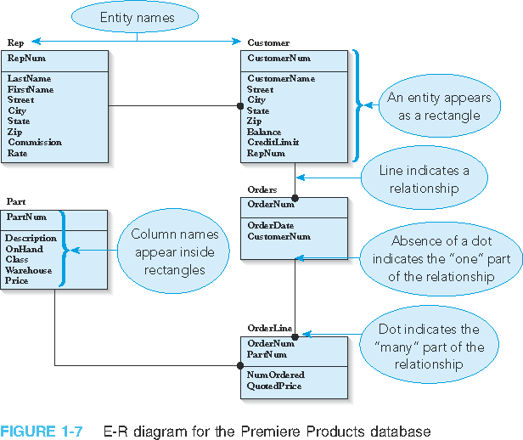
Example for Premier Database:
Relationship:
A Sales Rep could have one or more Customer
A Customer could have many Orders
An Order could have many OrderLines or actually many Products ordered
A Part or Product could have many Orders

Slide 27
Normalization
Normalization process
Identifying potential problems, called update anomalies, in the design of a relational database
Methods for correcting these problems
Normal form: table has desirable properties
First normal form (1NF)
Second normal form (2NF)
Third normal form (3NF)

Slide 28
Introduction (continued)
Normalization
Table in first normal form better than table not in first normal form
Table in second normal form better than table in first normal form, and so on
Goal: new collection of tables that is free of update anomalies

Slide 29
Functional Dependence
A
B
A certain field say Column B
is functionally dependent
on another field say Column A
if Column B’s value depend
on the value of Column A. And also that Column A’s value is associated only with a exactly one value of Column B.
And so if Column B depends on Column A then it also means that Column A functionally determines Column B.

Slide 30
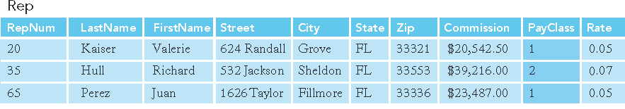
Functional Dependence (continued)
Let’s assume that in Premiere Products all Sales Rep in any given
Pay class earn the Commission Rate.
So, which means
a Sale’s Rep Pay Class
determines
his/her Commission Rate
And his/her Commission Rate
therefore depends
on his/her Pay Class
PayClass
Rate
FIGURE 1: Rep table with additional column, PayClass

Slide 31
Functional Dependence (continued)
Let’s make it a local example here. Suppose we have a Courses table below:
Course Code | Course Description
IS230 | Database Design
CA100 | Computer Literacy
BU101 | Intro to Business
Course Code
Course Description
That is, Course Code determines his/her Course Description
And Course Description depends on Course Code

Slide 32
Functional Dependence (continued)
Given an Employee table for which one field determines which field and which field depends which field?
SSS Number | Firstname | Lastname | Position
123456 | Butler | Joshua | Programmer
987654 | Cruz | John | Accountant
775577 | Miller | Mary | Secretary
888444 | Jones | River | Manager

Slide 33
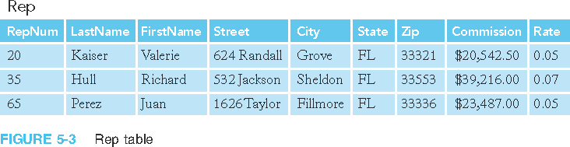
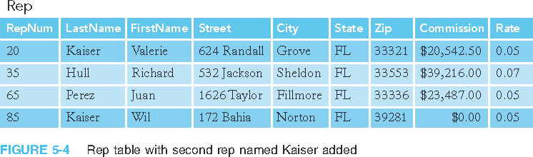
Let us examine Rep table on Premier Database
FIGURE 5-3: Rep table
FIGURE 5-4: Rep table with second rep named Kaiser added

Slide 34
Question?
In the CUSTOMER table , is CUSTOMER_NAME functionally dependent on REP_NUM?
In the ORDER_LINE table, is NUM_ORDERED functionally dependent on ORDER_NUM?
Is NUM_ORDERED is functionally dependent on PART_NUM?
On which columns in the ORDER_LINE table is NUM_ORDERED functionally dependent?
Is the CLASS column the primary key for the PART table?
Is the CUMSTOMER_NUM column the primary key for the CUSTOMER table?
Is the ORDER_NUM column the primary key for the ORDER_LINE table?
Is the combination for the ORDER_NUM and PART_NUM columns the primary key for the ORDER_LINE table?

Slide 35
Exercise
Identify which field(s) is functionally dependent on which field(s)
And then which field(s) functionally determines which field(s).
StudID | StudLast | StudFirst | HighSchoolNum | HighSchoolName | AdvisorNum | AdvisorName
1 | Cruz | John | 101 | CCA | 990 | Smith
2 | Moore | Anna | 102 | SDA | 991 | Song
3 | Friend | Fe | 101 | CCA | 991 | Song
4 | Zap | Mario | 103 | MNHS | 990 | Smith
5 | Bass | Gerard | 103 | MNHS | 992 | George

Slide 36
Primary Key and Functional Depedence
Primary key uniquely identifies a record or row.
The key in determining if column is functionally dependent to another column is to ask the question, is a certain column functionally dependent to the Primary Key.

Slide 37
Nothing but the Key
The key thought in normalization is the primary key.
To Quote E.F. Codd the father of relational database systems.
“[Every] non-key [attribute] must provide a fact about the key, the whole key, and nothing but the key.”

Slide 38
Three Normal Forms Mnemonics
In order to easily remember the three normal forms just remember the word RePeaT ignoring the vowels (which are in small letters) which are:
R – 1ST Normal Form - No Repeating groups or multi-valued fields
P – 2nd Normal Form - No Partial Dependence
T – 3rd Normal Form - No Transitional Dependence

Slide 39
First Normal Form
There should be no repeating group or multi-valued columns in order for a Table to be in first normal form.
Repeating group: multiple entries for a single record
Unnormalized relation: contains a repeating group

Slide 40
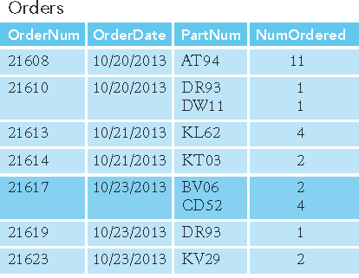
First Normal Form (continued)
Orders (OrderNum, OrderDate, (PartNum, NumOrdered) )
Multi-valued Columns
Multi-valued Columns
FIGURE 2: Sample unnormalized table

Slide 41
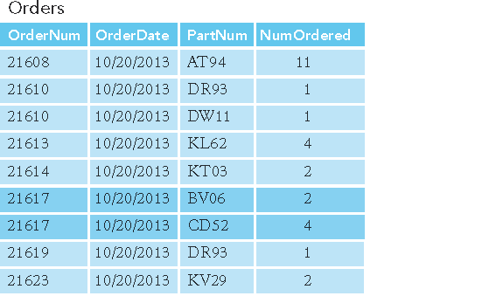
First Normal Form (continued)
Orders (OrderNum, OrderDate, PartNum, NumOrdered)
Converted to
First Normal Form
No more Multi-valued
fields
FIGURE 3: Result of normalization (conversion to first normal form)

Slide 42
First Normal Form (continued)
Below is a Table students and the course they are taking here at COM:
Students
StudentID | Lastname | Firstname | Program | CoursesTaken
457411 | Red | Ray | CIS | IS230, IS220
256742 | Zen | Anna | Education | EN210, EN215, EN110
444771 | Call | Sabrina | Business | BU250, BU260
Multi-Valued Column
Violates 1NF

Slide 43
First Normal Form (continued)
To convert to First Normal Form (1NF) is to remove the multi-value column
Students
StudentID | Lastname | Firstname | Program | CoursesTaken
457411 | Red | Ray | CIS | IS230, IS220
256742 | Zen | Anna | Education | EN210, EN215, EN110
444771 | Call | Sabrina | Business | BU250, BU260
X
Remove Multi-Value
Column

Slide 44
First Normal Form (continued)
Students
And create a new Table let’s say named CoursesTaken and relate the two.
StudentID | Lastname | Firstname | Program
457411 | Red | Ray | CIS
256742 | Zen | Anna | Education
444771 | Call | Sabrina | Business
CoursesTaken
CourseID | StudentID | CourseCode
101 | 457411 | IS230
102 | 457411 | IS220
103 | 256742 | ED210
104 | 256742 | ED215
105 | 256742 | EN110
106 | 444771 | BU250
107 | 444771 | BU260

Slide 45
First Normal Form (continued)
Below is a Table students and the course they are taking here at COM:
CoursesTaken
StudentID | Lastname | Firstname | Program | CourseCode
222333 | Khan | Bert | CIS | IS230
222333 | Khan | Bert | CIS | IS220
222333 | Khan | Bert | CIS | MS100
Repeating Groups violates 1NF

Slide 46
First Normal Form (continued)
To convert to First Normal Form (1NF) is to remove the multi-value column
CoursesTaken
StudentID | Lastname | Firstname | Program | CourseCode
222333 | Khan | Bert | CIS | IS230
222333 | Khan | Bert | CIS | IS220
222333 | Khan | Bert | CIS | MS100
X
Remove Repeating Groups

Slide 47
First Normal Form (continued)
And create a new Table let’s say named Students and relate the two.
CoursesTaken
CourseID | StudentID | CourseCode
101 | 222333 | IS230
102 | 222333 | IS220
103 | 222333 | ED210
Students
StudentID | Lastname | Firstname | Program
222333 | Khan | Bert | CIS

Slide 48
Exercise
Convert to 1NF the Table below which records the employee and his/her computer skills.
Employees
EmployeeID | Lastname | Firstname | Gender | Computer Skills
1 | James | George | M | Encoding, MS Office, Photoshop
2 | Miles | May | F | Encoding, Programming, Database Design
3 | Gates | Alan | M | Programming, MS Office

Slide 49
Second Normal Form (continued)
Table (relation) in second normal form (2NF)
Table is in first normal form
No nonkey column (not a primary key) column should be partially dependent of a composite primary key.
Partial dependencies: only on a portion of the primary key

Slide 50
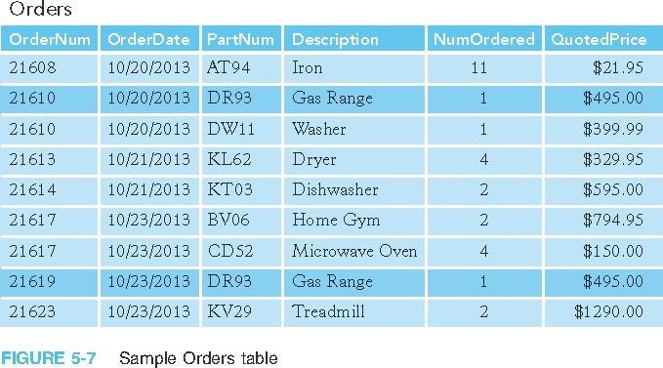
Second Normal Form
Primary Key : OrderNum and PartNum
OrderDate is partially dependent on OrderNum but not on both OrderNum and PartNum which is the composite Primary Key.
Description is partially dependent on PartNum but not on both OrderNum and PartNum which are the composite Primary Key.

Slide 51
Converting to Second Normal Form
OrderNum
X
OrderDate
Because the Primary Key is OrderNum and Partnum

Slide 52
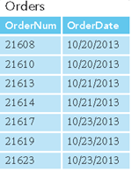
Converting to Second Normal Form
X
Remove partially dependent field OrderDate
And make a new table out of it let’s say in this case Orders table

Slide 53
Converting to Second Normal Form
PartNum
X
Description
Because the Primary Key is OrderNum and Partnum

Slide 54
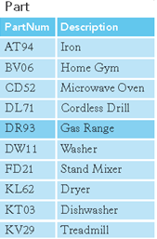
Converting to Second Normal Form
X
Remove partially dependent field Description
And make a new table out of it let’s say in this case Part table

Slide 55
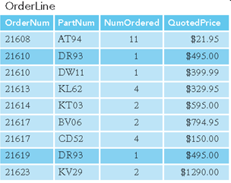
Converting to Second Normal Form
X
X
The Original table becomes a new table which is Normalized. And let’s say we name it OderLine table.

Slide 56
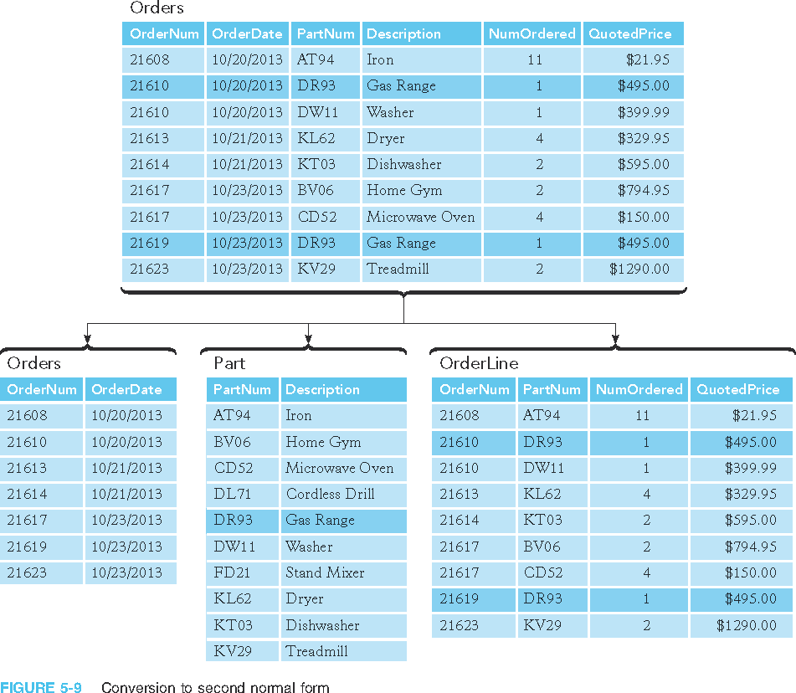
Second Normal Form (continued)
FIGURE 5-9: Conversion to second normal form

Slide 57
Second Normal Form (continued)
Below is a Table of the courses taken by students
CourseTaken
StudentID | Lastname | Firstname | Program | CoursesCode | CourseDescription
457411 | Red | Ray | CIS | IS230 | Database Design
457411 | Red | Ray | CIS | CA105 | Data Analysis
444771 | Call | Sabrina | Business | BU101 | Intro to Business
Lastname, Firstname, Program are
dependent on StudentID
but not on CourseCode and
StudentID
CourseDescription is
dependent on CourseCode
but not on CourseCode and
StudentID

Slide 58
Second Normal Form (continued)
To convert to 2NF remove partially dependent fields and make it as another table.
CourseTaken
StudentID | Lastname | Firstname | Program | CoursesCode | CourseDescription
457411 | Red | Ray | CIS | IS230 | Database Design
457411 | Red | Ray | CIS | CA105 | Data Analysis
444771 | Call | Sabrina | Business | BU101 | Intro to Business
X
X
Remove Partially
Dependent Fields
Remove Partially
Dependent Field

Slide 59
Second Normal Form (continued)
Converting into a new Table those who are partially dependent
Students
StudentID | Lastname | Firstname | Program
457411 | Red | Ray | CIS
444771 | Call | Sabrina | Business
Courses
CoursesCode | CourseDescription
IS230 | Database Design
CA105 | Data Analysis
BU101 | Intro to Business
CoursesTaken
StudentID | CoursesCode
457411 | IS230
457411 | CA105
444771 | BU101

Slide 60
Third Normal Form (continued)
Table (relation) in third normal form (3NF)
It is in second normal form
There should no non-primary key that is transitional dependent to a primary key.

Slide 61
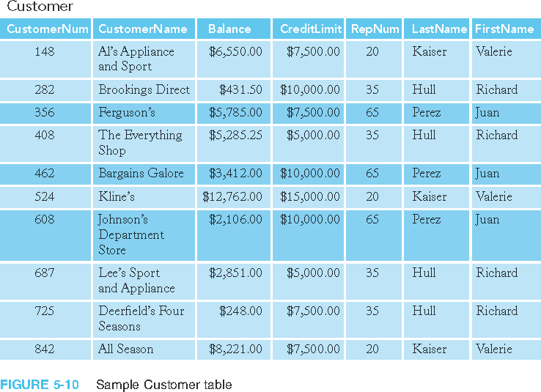
Third Normal Form (continued)
FIGURE 4: Sample Customer table

Slide 62
Third Normal Form
Customer (CustomerNum, CustomerName, Balance, CreditLimit, RepNum, LastName, FirstName)
Functional dependencies:
CustomerNum → CustomerName, Balance, CreditLimit, RepNum, LastName, FirstName
RepNum → LastName, FirstName

Slide 63
Third Normal Form (continued)
Correction procedure
Remove each column that is transitionally dependent.
Create a new table, transferring the removed columns to the newly created table.
Make a primary key of the new table
And use the primary key as the foreign key from the table where the columns were removed earlier.

Slide 64
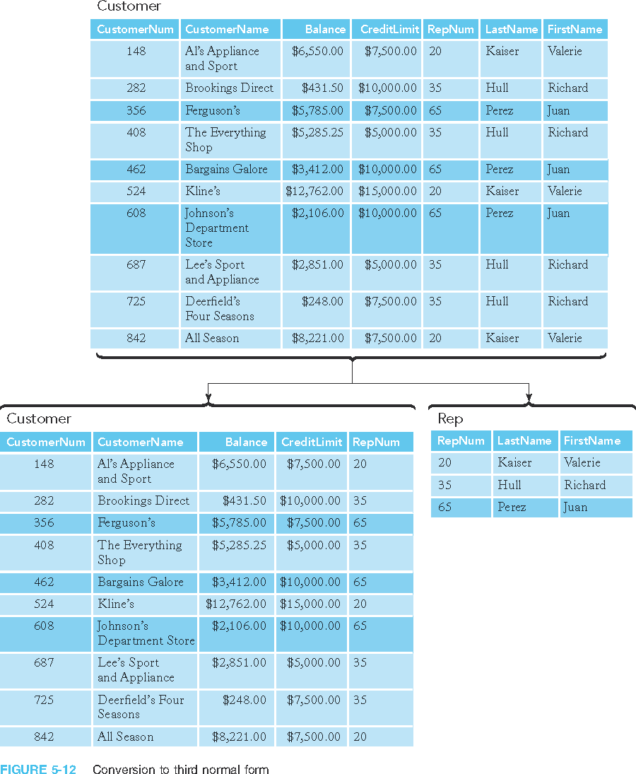
Third Normal Form (continued)
FIGURE 5: Conversion to third normal form

Slide 65
Third Normal Form (continued)
FIGURE 6: Conversion to third normal form (continued)

Slide 66
Incorrect Decompositions
Decomposition must be done using method described for 3NF
Incorrect decompositions can lead to tables with the same problems as original table

Slide 67
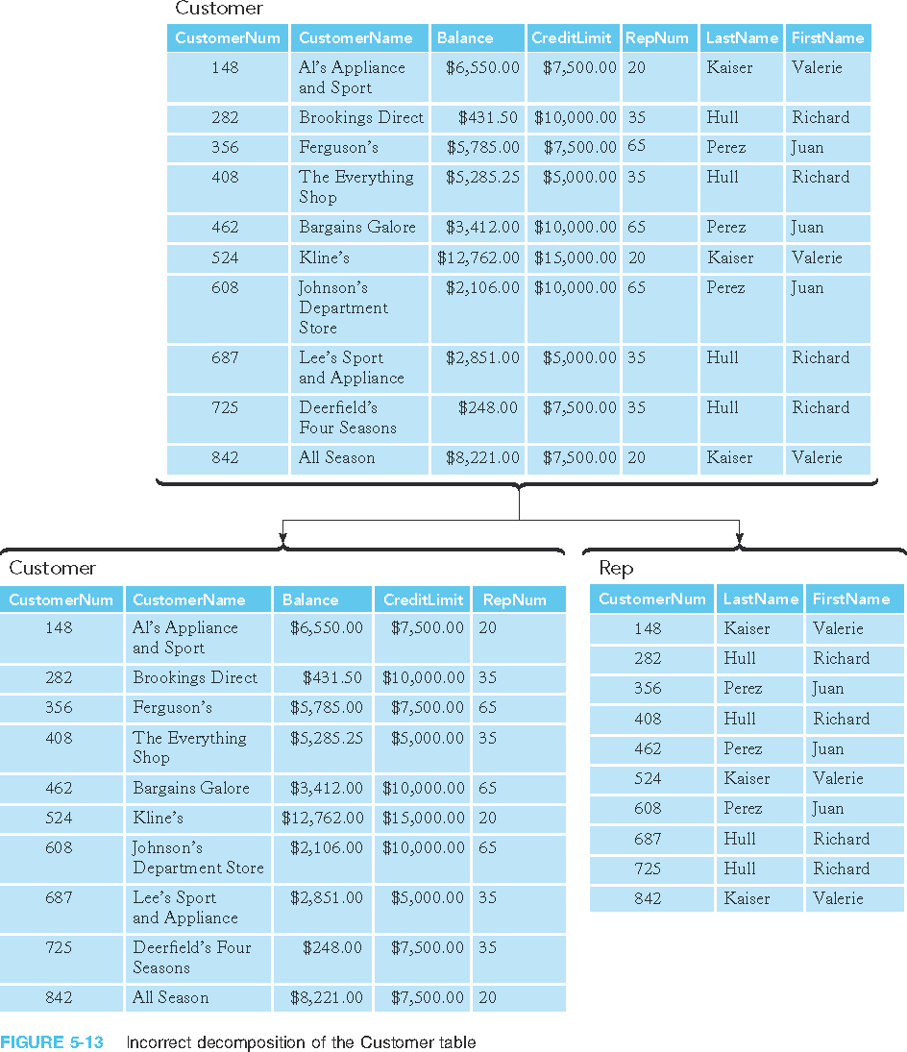
Incorrect Decompositions (continued)
FIGURE 7: Incorrect decomposition of the Customer table

Slide 68
Incorrect Decompositions (continued)
FIGURE 8: Incorrect decomposition of the Customer table (continued)

Slide 69
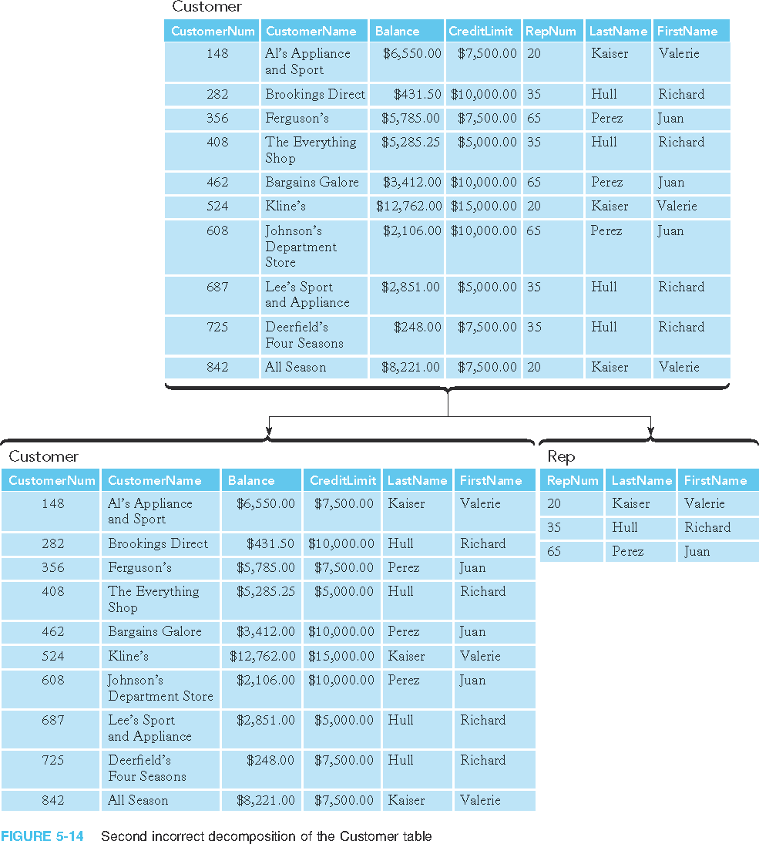
Incorrect Decompositions (continued)
FIGURE 9: Second incorrect decomposition of the Customer table

Slide 70
Incorrect Decompositions (continued)
FIGURE 10: Second incorrect decomposition of the Customer table (continued)

Slide 71
Third Normal Form (continued)
Below is a Table students the program he/she belongs here at COM
Students
StudentID | Lastname | Firstname | ProgramCode | ProgramName
12345 | Green | Arnel | CIS | Computer Information Systems
23456 | Azure | Zenaida | GenEd | General Education
34567 | Brown | Country | LA | Liberal Arts
ProgramName is
Dependent on ProgramCode
not StudentID which is
the PK

Slide 72
Third Normal Form (continued)
To convert to Third Normal Form (3NF) is to remove the Transitory Dependent column:
Students
StudentID | Lastname | Firstname | ProgramCode | ProgramName
12345 | Green | Arnel | CIS | Computer Information Systems
23456 | Azure | Zenaida | GenEd | General Education
34567 | Brown | Country | LA | Liberal Arts
X
Remove Transitory
Dependent Column

Slide 73
Third Normal Form (continued)
And create a new Table out of it let’s say we name it Programs and relate the two.
Students
StudentID | Lastname | Firstname | ProgramCode
12345 | Green | Arnel | CIS
23456 | Azure | Zenaida | GenEd
34567 | Brown | Country | LA
Programs
ProgramCode | ProgramName
CIS | Computer Information Systems
GenEd | General Education
LA | Liberal Arts

Slide 74
Third Normal Form (continued)
Or we could create a new Primary Key for Programs and do like this:
Students
StudentID | Lastname | Firstname | ProgramID
12345 | Green | Arnel | 1
23456 | Azure | Zenaida | 2
34567 | Brown | Country | 3
Programs
ProgramID | ProgramCode | ProgramName
1 | CIS | Computer Information Systems
2 | GenEd | General Education
3 | LA | Liberal Arts

Slide 75
Summary
Column (attribute) B is functionally dependent on another column A (or collection of columns) when each value for A in the database is associated with exactly one value of B
Column(s) A is the primary key if all other columns are functionally dependent on A and no sub-collection of columns in A also have this property

Slide 76
Summary (continued)
Table (relation) in first normal form (1NF) does not contain repeating groups
Nonkey column (or nonkey attribute) is not a part of the primary key
Table (relation) is in the second normal form (2NF) when it is in 1NF and no nonkey column is dependent on only a portion of the primary key
Determinant is a column that functionally determines another column

Slide 77
Summary (continued)
Table (relation) is in third normal form (3NF) when it is in 2NF and its only determinants are candidate keys
Collection of tables (relations) that is not in third normal form has inherent problems called update anomalies

Slide 78
Summary
Problems with nondatabase approaches to data management: redundancy, difficulties accessing related data, limited security features, limited data sharing features, and potential size limitations
Entity: person, place, object, event, or idea for which you want to store and process data
Attribute, field, or column: characteristic or property of an entity
Relationship: an association between entities

Slide 79
Summary (continued)
One-to-many relationship: each occurrence of first entity is related to many occurrences of the second entity and each occurrence of the second entity is related to only one occurrence of the first entity
Database: structure that can store information about multiple types of entities, attributes of entities, and relationships among entities
Premiere Products requires information about reps, customers, parts, orders, and order lines
Entity-relationship (E-R) diagram: represents a database visually by using various symbols

Slide 80
Summary (continued)
Database management system (DBMS): program through which users interact with a database; lets you create forms and reports quickly and easily and obtain answers to questions about the data
Advantages of database processing: getting more information from the same amount of data, sharing data, balancing conflicting requirements, controlling redundancy, facilitating consistency, improving integrity, expanding security, increasing productivity, and providing data independence

Slide 81
Summary (continued)
Disadvantages of database processing: larger file size, increased complexity, greater impact of failure, and more difficult recovery
Henry Books needs to store information about: branches, publishers, authors, books, inventory, and author sequence
Alexamara Marina Group needs to store information about: marinas, owners, marina slips, service categories, and service requests

